Slide 1
Bank Telemarketing
UT MSBA
Predictive Modeling
Team: Akhil, Joey, Matt, Pooshan
Notes:
Pooshan

Slide 2
Outline
Overview/Problem Statement
Hypothesis/EDA
Feature Selection
Model Fitting
Conclusions
Notes:
Pooshan

Slide 3
Data Set Overview
Portuguese banking company
Term Deposit
Telemarketing campaign
March 2008 – Nov. 2010
> 40,000 data points
20 inputs
Categorical and numerical
Age, marital status, loans, call duration, etc.
Source : UCI Machine learning repository
Notes:
Pooshan
The Great Recession started to hit Portugal in 2008; that year the Portuguese economy did not grow (0.0%) and fell almost 3% in 2009.

Slide 4
Problem Statement
The goal is to maximize the subscription rate for term deposits
Notes:
Pooshan - by predicting if a client will say yes/no to a term deposit

Slide 5
Hypothesis
Data Variables
Month
Duration
Number of Contacts
Previous Loans
Education
Day of the week
Response during previous campaign
External Factors
Economic Recession
2008 – 2009
Notes:
Pooshan

Slide 6
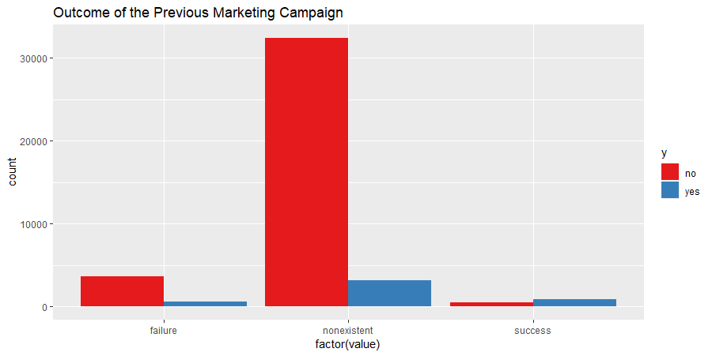
Exploratory Data Analysis
Term Deposits Distribution
Yes: 11.26%
No: 88.74%
Missing Values: 0
Categorical Variables: 10
Numeric Variables: 10
Notes:
Akhil

Slide 7
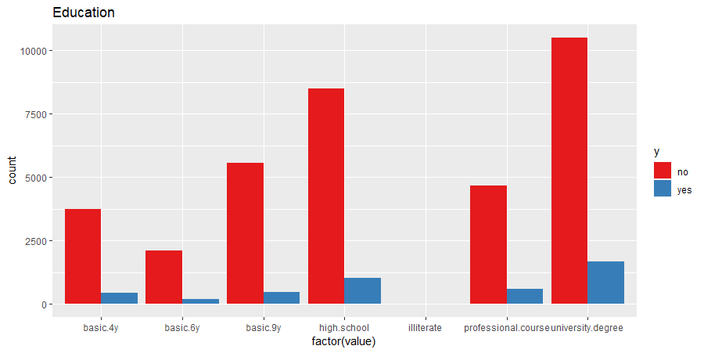
Exploratory Data Analysis
Notes:
Akhil

Slide 8
Feature Selection
Hypothesis Check
Method : Lasso
Month
Duration
Number of Contacts
Previous Loans
Education
Age Bins: | 60-80, 80-100
Jobs: | Blue Collar, Student
Month: | Mar, May, Jun, Jul, Nov.
Day of Week: | Monday
Education: | University Degree
Previous Campaign Outcome: | Success, Non-existent
Number of Employees
Duration of Call
Number of Days since Last Contact
Other Methods
Informational Value
Chi-Squared
Notes:
Akhil

Slide 9
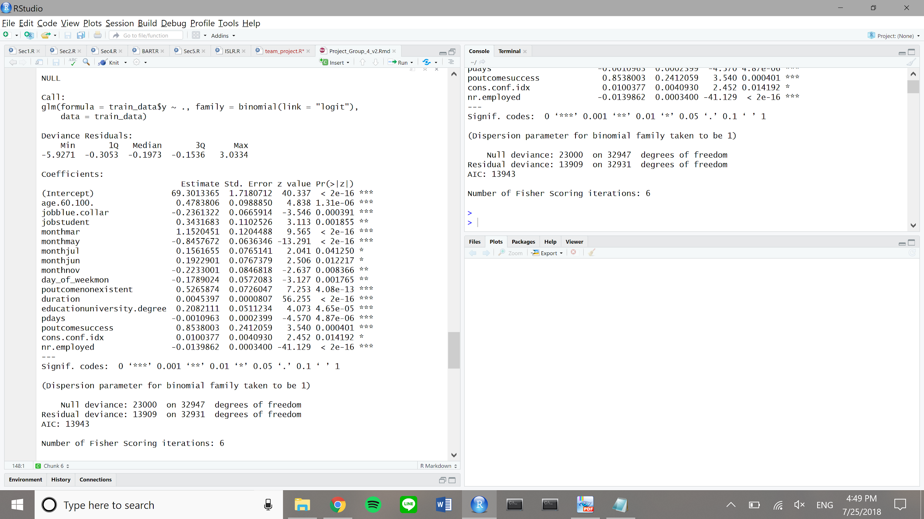
Model Fitting: Logistic Regression
Findings
Age
Job
Weekday
Duration
Employment
rate
Notes:
Joey
Why: because we have a classification problem, we tried a logistic regression

Slide 10
Model Fitting: Logistic Regression
0.5 Threshold
0.3 Threshold
 | Predicted No | Predicted Yes
Actual No | 7114 | 194
Actual Yes | 530 | 398
Predicted No | Predicted Yes
6938 | 370
371 | 557
Misclassification Rate | 0.09
Recall | 0.43
False Positive Rate | 0.03
Specificity | 0.97
Precision | 0.67
0.09
0.60
0.05
0.95
0.60
Notes:
Joey
Why: because we have a classification problem, we tried a logistic regression

Slide 11
Model Fitting: Random Forest
 | Predicted No | Predicted Yes
Actual No | 6940 | 368
Actual Yes | 445 | 483
Misclassification Rate | 0.1
Recall | 0.52
False Positive Rate | 0.05
Specificity | 0.95
Precision | 0.58
Notes:
Matt

Slide 12
Recommendations
 | Logistic Regression Model
 | More Information Income Year of Contact Children
 | Be Persistent on Call
Notes:
Matt

Slide 13
Lessons
Curating the code: setting seeds
Using ROC over misclassification rate in logistic regression
Random Forest: more trees/iterations does not mean better output
KNN: dealing with both categorical and numerical data in models
Notes:
Akhil, Joey, Matt, Pooshan
KNN
Random forest: having more trees/iterations started creating worse models due to possible overfitting
Curating the code: customizing modules to our data and understanding why things worked/didn’t work
Using ROC over cross-validation in logistic regression
seed

Slide 14
Questions?
Notes:
Pooshan

Slide 15
Appendix

Slide 16
Data Treatments
Duration = 0 has to be removed to remove customers that are not contacted
Create bins for age
Checking the missing values
mismap() plot to check the missing values visually
Checking if the categorical variables are classified as factor variables
Changing the yes and no values to 1 and 0 in the y variable

Slide 17
Variable Importance Plot: Random Forest

